Slide 1
Chapter Twelve
Hardware and Network Troubleshooting

Slide 2


220-901 Objectives Covered
2.9 Given a scenario, use appropriate networking tools.
  Crimper
  Cable stripper
  Multimeter
  Tone generator & probe
  Cable tester
  Loopback plug
  Punch-down tool
  Wi-Fi analyzer
4.1 Given a scenario, troubleshoot common problems related to motherboards, RAM, CPU and power with appropriate tools.
  Common symptoms
    Unexpected shutdowns
    System lockups
    POST code beeps
    Blank screen on bootup
    BIOS time and settings resets
    Attempts to boot to incorrect device
    Continuous reboots
    No power
    Overheating
    Loud noise
    Intermittent device failure
    Fans spin – no power to other devices
    Indicator lights
    Smoke
    Burning smell
    Proprietary crash screens (BSOD/pin wheel)
    Distended capacitors
  Tools
    Multimeter
    Power supply tester
    Loopback plugs
    POST card / USB

Slide 3
220-901 Objectives Covered
4.2 Given a scenario, troubleshoot hard drives and RAID arrays with appropriate tools.
  Common symptoms
    Read/write failure
    Slow performance
    Loud clicking noise
    Failure to boot
    Drive not recognized
    OS not found
    RAID not found
    RAID stops working
    Proprietary crash screens (BSOD/pin wheel)
    S.M.A.R.T. errors
  Tools
    Screwdriver
    External enclosures
    CHKDSK
    FORMAT
    File recovery software
    Bootrec
    Diskpart
    Defragmentation tool
4.3 Given a scenario, troubleshoot common video, projector and display issues.
  Common symptoms
    VGA mode
    No image on screen
    Overheat shutdown
    Dead pixels
    Artifacts
    Color patterns incorrect
    Dim image
    Flickering image
    Distorted image
    Distorted geometry
    Burn-in
    Oversized images and icons

Slide 4
220-901 Objectives Covered
4.4 Given a scenario, troubleshoot wired and wireless networks with appropriate tools.
  Common symptoms
    No connectivity
    APIPA/link local address
    Limited connectivity
    Local connectivity
    Intermittent connectivity
    IP conflict
    Slow transfer speeds
    Low RF signal
    SSID not found
  Hardware tools
    Cable tester
    Loopback plug
    Punch-down tools
    Tone generator and probe
    Wire strippers
    Crimper
    Wireless locator
  Command line tools
    PING
    IPCONFIG/IFCONFIG
    TRACERT
    NETSTAT
    NBTSTAT
    NET
    NETDOM
    NSLOOKUP
4.5 Given a scenario, troubleshoot and repair common mobile device issues while adhering to the appropriate procedures.
  Common symptoms
    No display
    Dim display
    Flickering display
    Sticking keys
    Intermittent wireless
    Battery not charging
    Ghost cursor/pointer drift
    No power
    Num lock indicator lights
    No wireless connectivity
    No Bluetooth connectivity
    Cannot display to external monitor
    Touchscreen non-responsive
    Apps not loading
    Slow performance
    Unable to decrypt email
    Extremely short battery life
    Overheating
    Frozen system
    No sound from speakers
    GPS not functioning
    Swollen battery
  Disassembling processes for proper re-assembly
    Document and label cable and screw locations.
    Organize parts.
    Refer to manufacturer resources.
    Use appropriate hand tools.
Notes:
You need abase level knowledge before troubleshooting
Try to follow a logical process
Take a systematic approach
Check the easy stuff first such as physical connections
See if something has changed
Narrow down the scope of the problem i.e. eliminate all variables

Slide 5
220-901 Objectives Covered
4.6 Given a scenario, troubleshoot printers with appropriate tools.
  Common symptoms
    Streaks
    Faded prints
    Ghost images
    Toner not fused to the paper
    Creased paper
    Paper not feeding
    Paper jam
    No connectivity
    Garbled characters on paper
    Vertical lines on page
    Backed up print queue
    Low memory errors
    Access denied
    Printer will not print
    Color prints in wrong print color
    Unable to install printer
    Error codes
    Printing blank pages
    No image on printer display
  Tools
    Maintenance kit
    Toner vacuum
    Compressed air
    Printer spooler

Slide 6
General Hardware Issues
Heat
Noise
Odors and smoke
Status lights
Alerts
Visible damage
Notes:
Heat
Excessive heat can damage components even though they are built to withstand certain amount of heat. Processors MUST have heat sinks.
Fans must function to prevent the internal components from overheating. Power supply fans, CPU fans, video card fans if present, memory fans if present etc.
Use a blower to blow out dust or compressed air
Noise
Some noises are normal
Power supply fan, CD drives, hard drives – mechanical moving parts
Fingernail on chalkboard sound could indicate mechanical hard drive crash
Some Post beeps could indicate missing memory, hard drives etc.
Odors and smoke
Always bad. Shut down immediately and unplug.
Open case and look for physical damage – capacitors, processors etc.

Slide 7
General Hardware Issues
Heat
Noise
Odors and smoke
Status lights
Alerts
Visible damage
Notes:
Status lights
Power light should come on when a device is on – router, switch, pc, printer etc.
Port lights should be on In switches
Some green=good, Red=bad.
Printers amber light for paper jam etc
Hard drive activity lights
Keyboard – CAPS, NUM lock keys
Alerts
Severs have display panels that indicate failure like power (if redundant), HDD etc
Printers also have display panels
Computer screen pop ups
Event log – OS errors.
Visible damage
In most cases the part will need replacement
Monitor new component after.

Slide 8
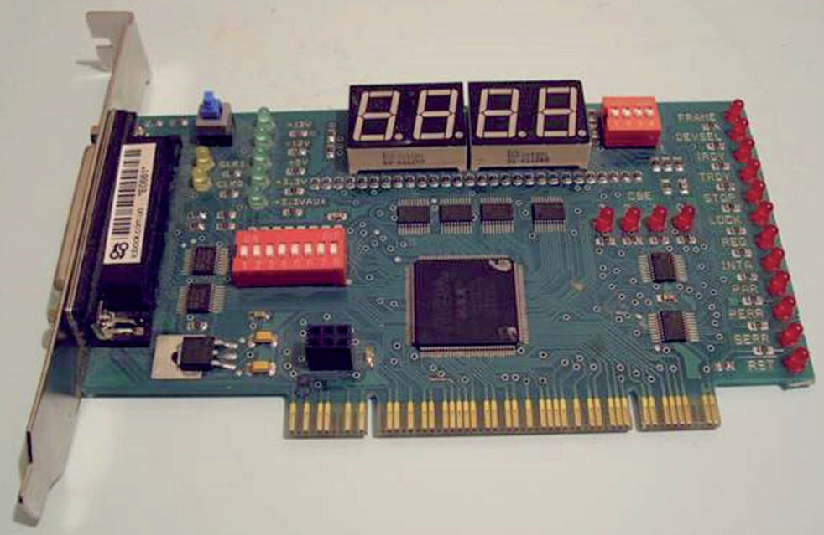
POST Routines
Beep codes
POST card
BIOS issues
Notes:
POST - Diagnostic program built into the BIOS
Checks CPU, RAM, Video card for hardware functionality
Boot process stops if an error is detected
Beep codes – series of beeps from computer speaker.
Single beep – OK. Long beeps or more than one beep indicate failure – this differs for each manufacturer. You should get a beep code chart for your BIOS
POST card – Pci or PCIe expansion card that reports numeric codes corresponding to a particular component being checked. Newer models are USB and can be used on laptops or desktops without opening the case
BIOS issues
Bios go out of date and don’t go bad
BIOS software is written on EEPROM (Electronically erasable Progammable Read Only memory) and can be updated. This is called Flashing the BIOS
If BIOS does not retain information check the CMOS battery
BIOS contains the boot sequence – check primary and secondary boot devises if PC does not bot

Slide 9
Specific Core Hardware Problems
Motherboards
CPUs
Memory
Power supply
Cooling
Storage devices
DVD/CD-ROMs and other removable media
Video issues
Notes:
Motherboards
“completely dead” can be a symptom of a wide variety of problems,
not only with the CPU or motherboard but also with the RAM or the power supply
Complete lockup or hanging could indicate bad motherboard, CPU or RAM – requires hard reboot
Motherboard damage requires complete replacement and not repair
To minimize the risk, observe the following rules:
■■ Handle a motherboard as little as possible, and keep it in an antistatic bag whenever it’s removed from the PC case.
■■ Keep all liquids well away from the motherboard; water can cause a short circuit.
■■ Wear an antistatic wrist strap when handling or touching a motherboard.
■■ When installing a motherboard in a case, make sure you use brass standoffs with paper or plastic washers to prevent any stray solder around the screw holes from causing a short circuit with the metal of the screw.

Slide 10
Laptop Issues
Power
Video
Input
Network
Responsiveness

Slide 11
Printer Problems
Dot-matrix
Inkjet
Laser

Slide 12
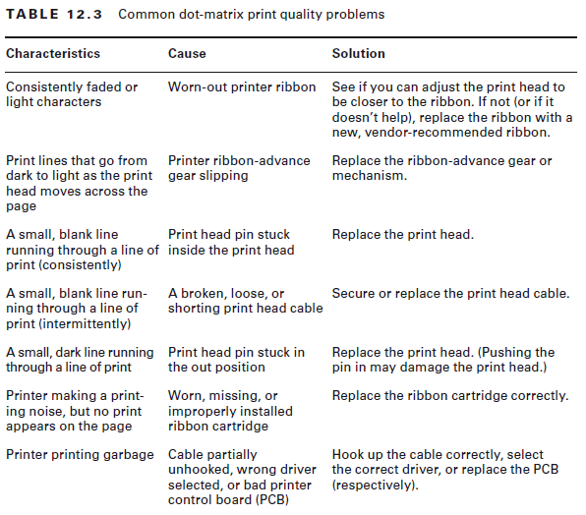
Dot Matrix Issues
Low print quality or missing dots

Slide 13
Dot Matrix Issues
Paper jam issues
Three general causes of printer jams:
Obstructed paper path,
Stripped drive gears, and
Wrong paper used.
Stepper Motor Problems
Carriage motor moves the print head back and forth and the main motor advance paper.
If the main motor is damaged (which is more likely to happen), lines of print will be unevenly spaced
If the print head motor goes bad, characters will be scrunched together.
If a stepper motor is damaged badly enough, it won’t move at all
Replace but very expensive!

Slide 14
Inkjet Printer Issues
Print Quality
99% of quality issues can be traced to a faulty ink cartridge
Example, thin blank lines in every line of text on the page. This is caused by a plugged hole in at least one of the small, pinhole ink nozzles in the print cartridge.
If an ink cartridge becomes damaged or develops a hole, it can put too much ink on the page and the letters will smear.
Faded print
For all the above – Replace cartridge
The print quickly goes from dark to light and then prints nothing. PS: ink cartridges dry out if not used hencethe suction If this priming pump is broken or malfunctioning, this problem will manifest itself - Replace pump

Slide 15
Inkjet Printer Issues
Color Output Problems

Slide 16
Managing Print Jobs
Print queue
Print spooler
Printing a test page

Slide 17
Networking – Connectivity Issues
No connectivity
APIPA and link local addresses
Address conflicts
Limited or local connectivity
Intermittent connectivity
SSID not found

Slide 18
Hardware Tools
Wire strippers and crimpers
Multimeter
Toner probe
Cable tester
Punch-down tool
Loopback plug
Wireless locator

Slide 19
Software Tools
PING
IPCONFIG
TRACERT
NETSTAT
NBTSTAT
NET
NETDOM
NSLOOKUP
Notes:
PING - sends a series of packets to another system, which in turn sends back a response. It indicates whether the host can be reached and how long it took for the host to send a return packet. The syntax for PING is ping hostname or ping IP address. See Table 12.6 for ping options
IPCONFIG command is perhaps the most used utility in troubleshooting and network configuration. You can use IPCONFIG to view your computer’s IP configuration and PING to test connectivity between two network hosts The IPCONFIG /RENEW command will send a query to the DHCP server asking it to resend and renew all DHCP information. For a more detailed look at the IPCONFIG command, type IPCONFIG /? at the command prompt.
Tracert is a Windows command-line utility that enables you to verify the route to
a remote host. It is often used in the troubleshooting process to verify the path a data
packet takes toward its final destination.
NETSTAT shows network statistics, i.e. inbound and outbound connections as well as packets sent/received and the number of errors
NBTSTAT shows NetBIOS over TCP/IP information; it can be useful when trying to diagnose a problem with NetBIOS name resolution
NET allows you to perform network management tasks such as sharing folders,
NET SHARE <share_name>=<drive_letter>:<path>
Exercise 12.6 page 649

Slide 20
Software Tools
PING
IPCONFIG
TRACERT
NETSTAT
NBTSTAT
NET
NETDOM
NSLOOKUP
Notes:
NETDOM is used for network domain administration; Active Directory management capabilities, specifically domain and trust management. You can :
Rename a computer that is a member of a domain.
Join a client computer (Windows XP or newer) to a Windows domain.
Manage computer accounts within a domain, such as adding or removing computers, changing the organizational unit (OU) for the computer, or moving a computer from one domain to another.
Establishing and managing trust relationships between domains.
NSLOOKUP allows you to query a DNS server and verify entries on the DNS server

